Slide 1
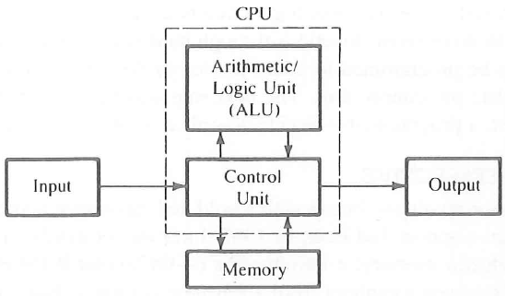
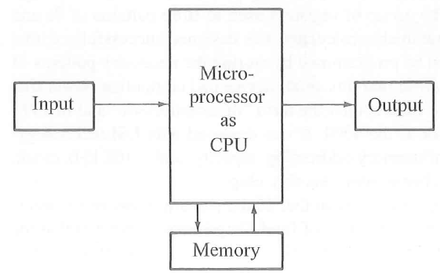
Block Diagram of a computer with microprocessor as CPU
87
Figure 1[1] Block diagram of a computer

Slide 2
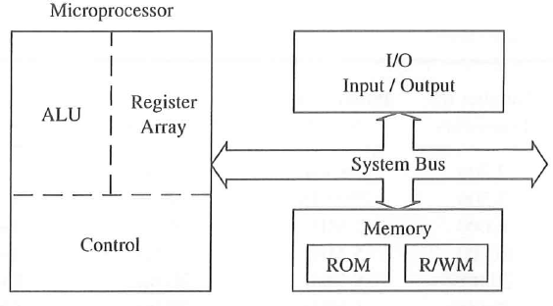
Microprocessor –Based System with Bus Architecture
87
Component of Microprocessor Based System:-
- Microprocessor
- ALU
  Register Array
  Control Unit
  Memory
  I/O
  System Bus
Figure 2[1] Bus architecture

Slide 3
Overview: 8085 Programming model
2
Six general-purpose Registers
Accumulator Register
Flag Register
Program Counter Register
Stack Pointer Register

Slide 4
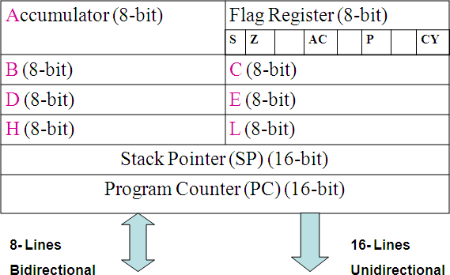
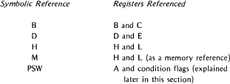
Programming Model
3
Figure 3 [1] Bus architecture

Slide 5
Registers
The 8085 has six general-purpose registers to store 8-bit data
these are identified as B,C,D,E,H, and L
They can be combined as register pairs -BC, DE, and HL - to perform some 16-bit operations
The programmer can use these registers to store or copy data into the registers by using data copy instructions.

Slide 6
Accumulator
The accumulator is an 8-bit register that is a part of arithmetic/logic unit (ALU).
This register is used to store 8-bit data and to perform arithmetic and logical operations.
The result of an operation is stored in the accumulator.
The accumulator is also identified as register A.

Slide 7
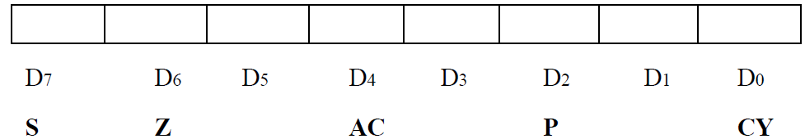
Flags
The ALU includes five flip-flops, which are set or reset after an operation according to data conditions of the result in the accumulator and other registers.
They are called Zero(Z), Carry (CY), Sign (S), Parity (P), and Auxiliary Carry (AC) flags;
Their bit positions in the flag register are shown in the Figure below.
The most commonly used flags are Zero, Carry, and Sign. The microprocessor uses these flags to test data conditions.

Slide 8
Flags
For example, after an addition of two numbers, if the sum in the accumulator id larger than eight bits, the flip-flop uses to indicate a carry -- called the Carry flag (CY) – is set to one.
When an arithmetic operation results in zero, the flip-flop called the Zero(Z) flag is set to one.
These flags have critical importance in the decision-making process of the microprocessor.
The conditions (set or reset) of the flags are tested through the software instructions.
For example, the instruction JC (Jump on Carry) is implemented to change the sequence of a program when CY flag is set.

Slide 9
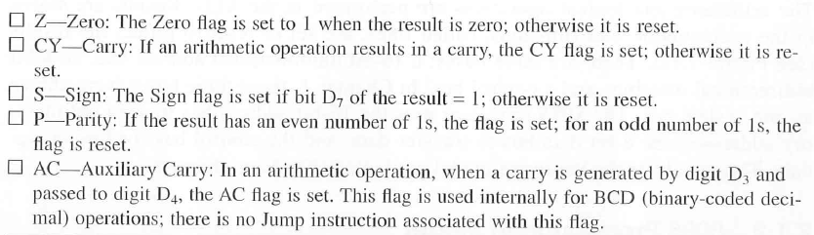
Flags

Slide 10
Program Counter (PC)
This 16-bit register deals with sequencing the execution of instructions.
This register is a memory pointer. Memory locations have 16-bit addresses, and that is why this is a 16-bit register.
The microprocessor uses this register to sequence the execution of the instructions.
The function of the program counter is to point to the memory address from which the next byte is to be fetched
When a byte (machine code) is being fetched, the program counter is incremented by one to point to the next memory location.

Slide 11
Stack Pointer (SP)
The stack pointer is also a 16-bit register used as a memory pointer.
It points to a memory location in R/W memory, called the stack.
The beginning of the stack is defined by loading 16-bit address in the stack pointer.

Slide 12
Program-Adding Two hexadecimal Nos.
Write a program to add two hexadecimal numbers 32H and 48H in register A and B respectively. Add the numbers and display the sum at output port PORT 1.
Problem Analysis:
1. Load the numbers in the registers
2. Add the numbers
3. Display the sum at output port 1

Slide 13
Flowchart: Adding two numbers
Start
MVI A, 32H
MVI B, 48H
ADD B
OUT 01H
HALT
Load Hex numbers
Add numbers
Display Sum
End

Slide 14
References
1. Gaonkar, R. S. (1990). Microprocessor Architecture, Programming and Applications with the 8085. Fifth Edition Prentice Hall PTR.

